Slide 1





Awesome
Author!!
You are an. . .

Slide 2
Remember. . .
Use your senses!
What can you see, hear, taste, touch and smell? Think of your reader! Bring the story alive by describing objects and surroundings.
Use a variety of favourite words! Collect these words in out vocabulary vault.
Be inspired by the books that you read… imitation is good!
!

Slide 3
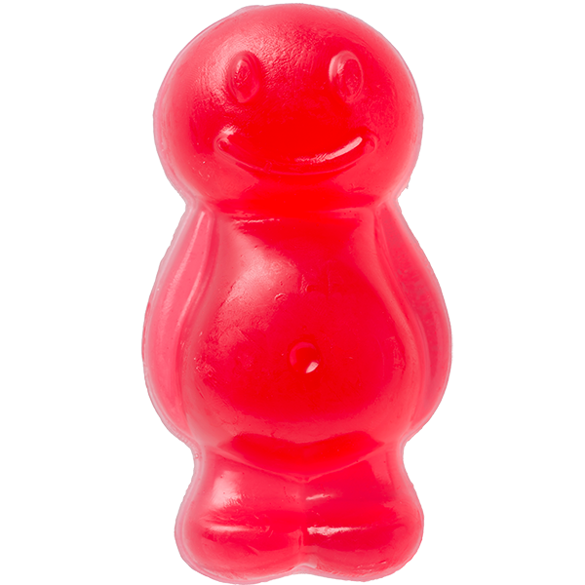
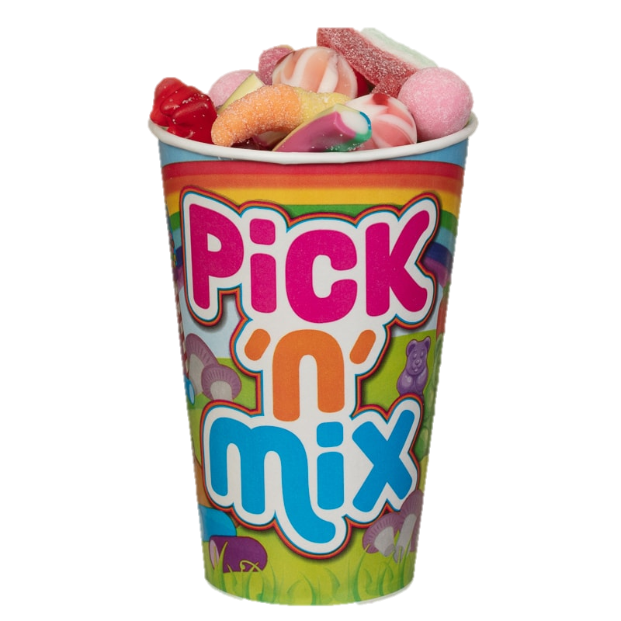
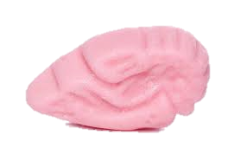

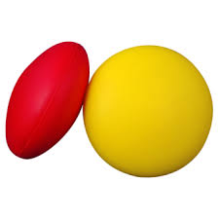

Inspire exciting writing
Inspire children’s writing
ADJECTIVES
PUNCTUATION
Compare a piece of writing to a delicious and tempting sweet
treat! You don’t want too much of the same thing. A little bit of
this and that is good! A few wonderful adjectives, a short, dramatic sentence followed by a simple simile. A fabulous professional opener, 3 short sharp sentences and a conjunction to add more detail! Make it amazing! Excite the reader! Variety is the spice of life!
CONJUNCTION
SPEECH
HANDWRITING

Slide 4
Inspire exciting writing
Inspire children’s writing
ADJECTIVES
PUNCTUATION
CONJUNCTION
SPEECH
HANDWRITING

Slide 5
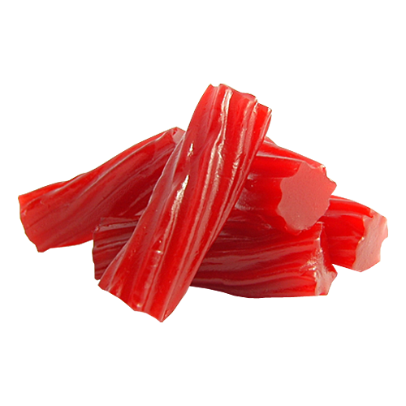

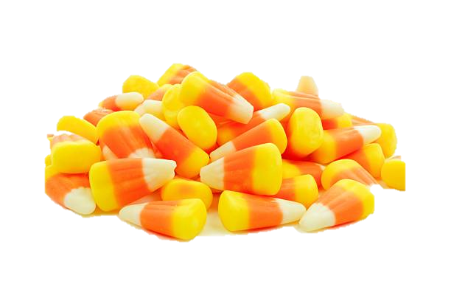
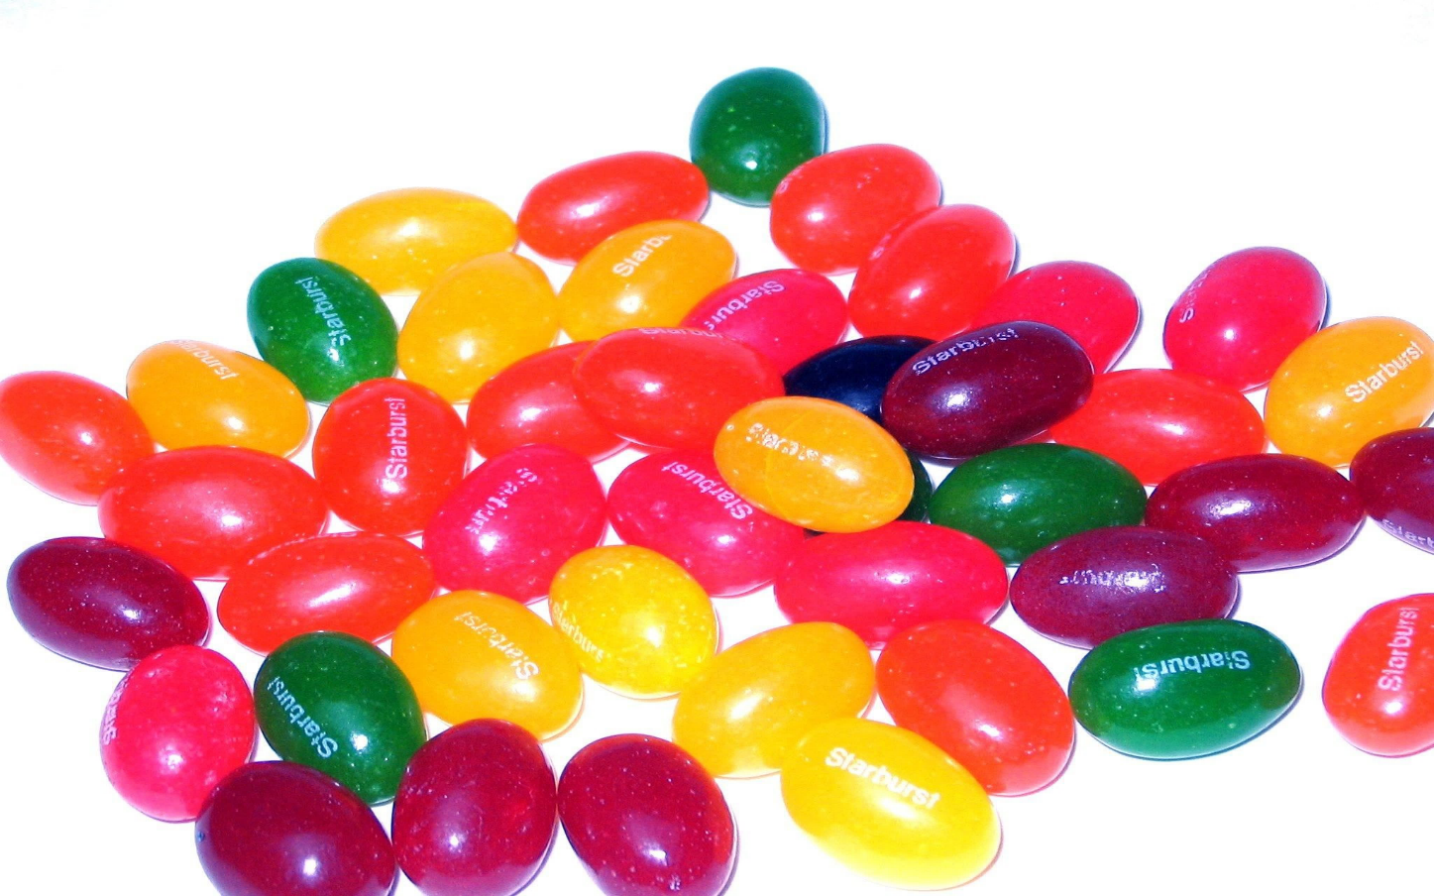
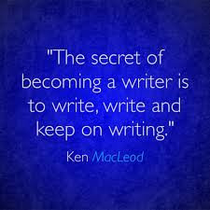
Inspire exciting writing
Inspire children’s writing
SHORT
SENTENCES
LONGER SENTENCES
SIMILE
OPENERS

Slide 6
Let’s review. . .
Characters….
Have you told us about your characters feelings through their movement and actions?
Read though your work with your friend. Name 2 things that are great and then one thing you might include next…
Change one word – if you need to! If sad is the right word then keep it! If not, grab a thesaurus! You are the author!

Slide 7

Vocabulary Vault

Slide 8
Celebrate. . . !
Adjectives of
the day…
Great
description!
Sentence of
the day…
Most
improved
author today…
Perfect
punctuation!
Well
written!!

