Slide 1


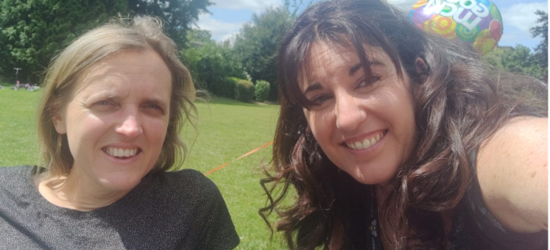

Supporting your child’s return to school
EPS East Team
Dr Katy Cole (Senior EP) and Dr Nikki Collingwood (EP)
Hertfordshire County Council
www.hertsdirect.org

Slide 2




Overview
How can I make sense of my child’s responses during this time?
What is important for their learning, wellbeing and engagement going forward?
How can I support my child to feel settled about being in school?
What can I do if I need more advice?

Slide 3






How might your child have been impacted?
Loss of routine
Loss of structure
Loss of friendship
Loss of opportunity
Loss of freedom
Recovery Curriculum (Carpenter & Carpenter, 2020)
https://www.evidenceforlearning.net/recoverycurriculum

Slide 4

Young People’s Emotional Wellbeing Survey – June 2020
Commissioned by CAMHS
What do children and young people say about how they are feeling about returning to school?

Slide 5
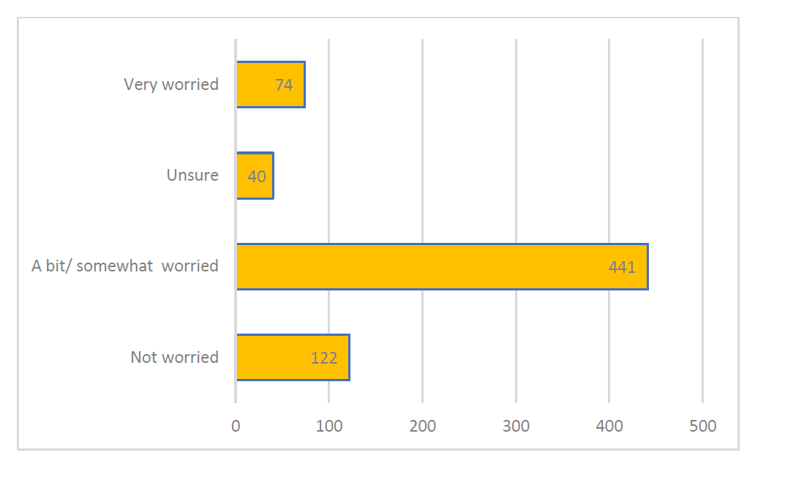
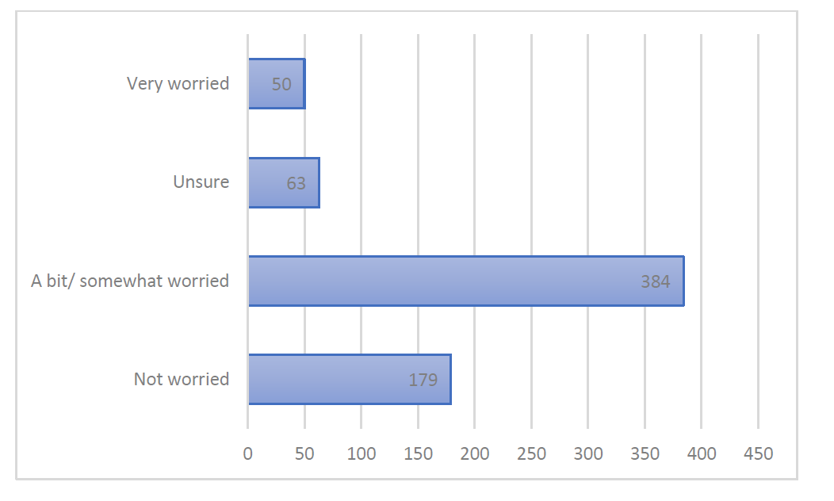
Are you worried about the effect that the Coronavirus is having on your life/your parents lives right now?

Slide 6
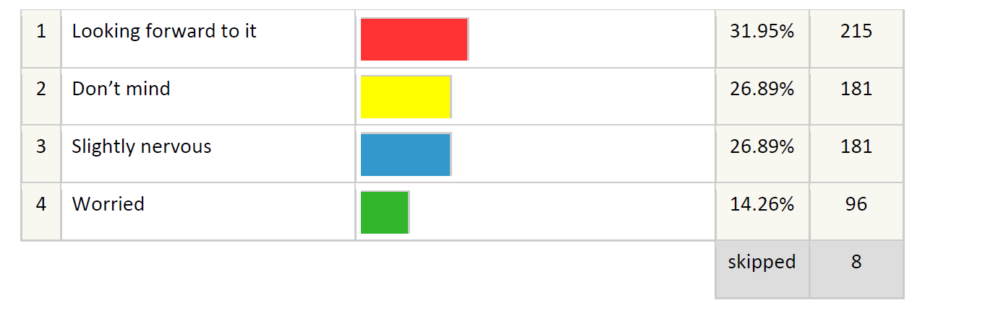
How do you feel about returning to school when that happens?

Slide 7
Write a word or sentence about how you are feeling about returning to school
Seeing friends
Excited
Nervous
Worried
Happy
Looking forward to it
Anxious
Scared
Being behind with school work
Relieved

Slide 8
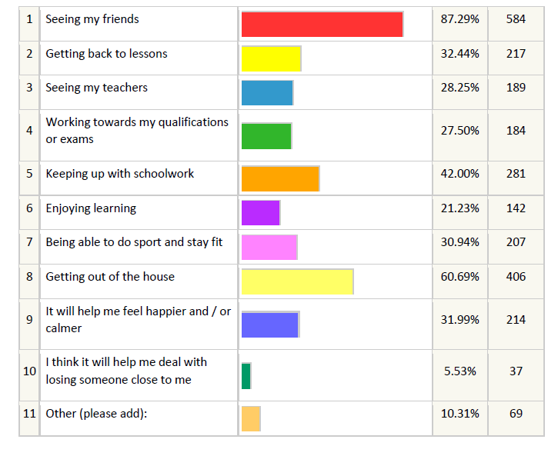
What are you looking forward to about returning to school?

Slide 9
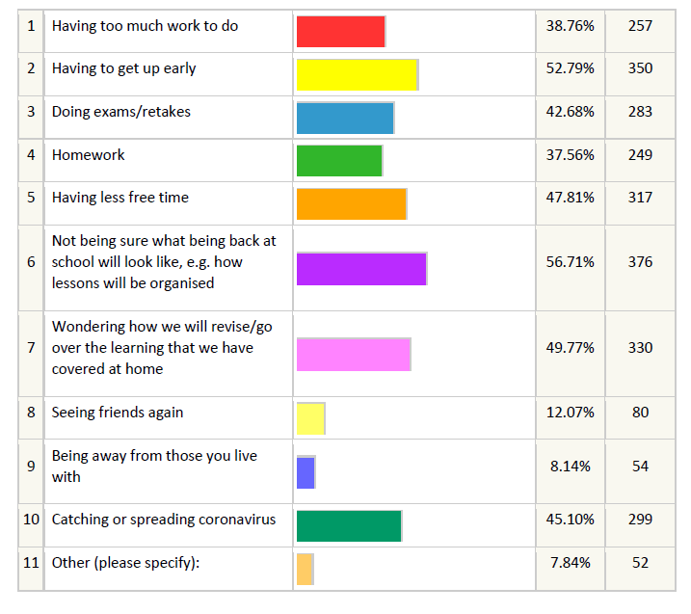
When you think about returning to school, is there anything in particular that makes you feel worried?

Slide 10
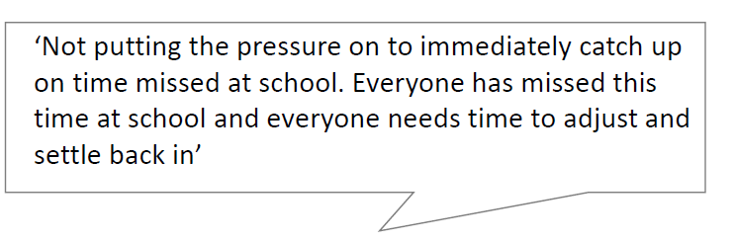

It’s important to listen to what they are saying…

Slide 11
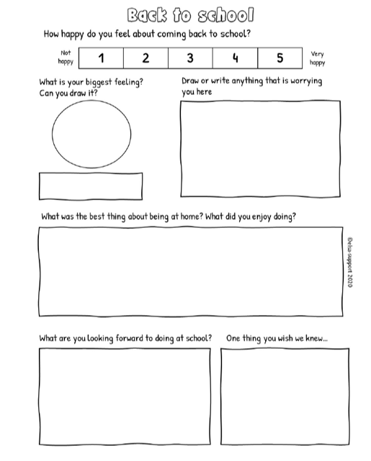
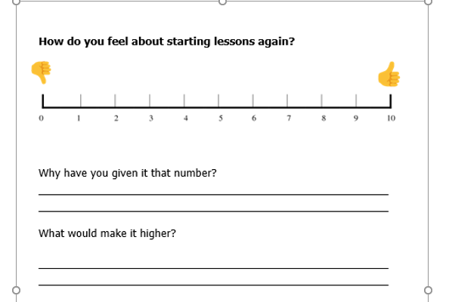
It’s important to listen to what they are saying….
Sentence starters
When I think of school, I think/feel…
The thing I am looking forward to most is…
Returning to school would be better if…
Lists
List the positives and negatives of returning to school and ways to improve / cope with the negatives.
Card sorting activities
Matching parts of the school day to different emotions or a thumbs up and thumb down

Slide 12





What is important for your child’s well-being, learning and engagement going forward?
Sense of Safety
Sense of self- and community-efficacy
Calmness
Connectedness
Hope
Hobfoll et al (2007) – Essential Elements of Mass Trauma Intervention

Slide 13
How can I support my child to feel settled about returning and being in school?
Connectedness
Sense of Safety
Hope
Calmness
Sense of self- efficacy
Build strong relationships with your child
Prepare your child for transitions
Help your child to be ready for learning

Slide 14
Build strong relationships with your child
Emotional experiences need to be validated and understood.
Children and young people need to regulate and connect before they can learn.
Parents and carers are key role models in showing children and young people how and ways to regulate their emotions and responses.
Relationships amongst peers is critical and development and reconnection should be a priority.
Connectedness
Build strong relationships with your child

Slide 15
Prepare your child for transitions to help them feel safe
Help them to start getting back to healthy sleep routines.
Help them to think of what they need to do to get used to school routines and preparing for school.
Provide gradual experiences of being out of the house.
Start weaning off social media by providing progressively tighter boundaries.
Help them understand any new arrangements regarding Covid-19.
Sense of Safety
Prepare your child for transitions

Slide 16
Prepare your child for transitions to help them feel safe
Prioritise wellbeing for all in the family.
Keep in contact with staff around concerns.
Generate a shared language that is positive to encourage an atmosphere of feeling safe.
Adopt a compassionate and calm approach.
Sense of Safety
Prepare your child for transitions

Slide 17
Help your child to be ready for learning
Initial focus should be on readiness for learning (not on content immediately).
Provide reassurance to your children about their learning.
Developing ways to enhance self-efficacy is important.
Find natural opportunities for learning.
Hope
Calmness
Sense of self- efficacy
Help your child to be ready for learning

Slide 18
What can I do if I need more advice?
Educational Psychology Service Helpline or Specialist Advisory Teacher Helpline
School Mental Health Lead or SENCO
DSPL local support
School Nurse
Hertfordshire YC (Youth Connexions)
Information on all of the above and more are on the Hertfordshire
Local offer. https://www.hertfordshire.gov.uk/microsites/Local-Offer/The-Hertfordshire-Local-Offer.aspx (or google: Hertfordshire Local Offer)

