Slide 1

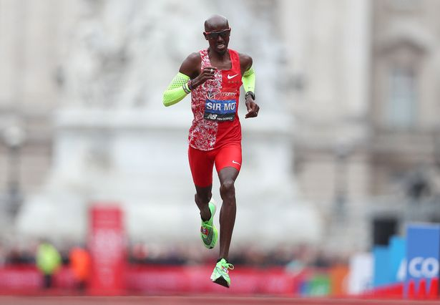
Black History Month – Influential Person of the Day
Mo Farah
The Olympic champion went to Feltham Community College and Isleworth & Syon School as he grew up in Hounslow, having moved to the area after his family fled Somalia.
Following his success at the London 2012 Olympics, postboxes in Isleworth and Teddington, where he used to live, were painted gold to commemorate is achievements.
He's the most successful British track athlete in modern Olympic Games history, he is the 2012 and 2016 Olympic gold medalist in both the 5000-metre and 10,000-metre

Slide 2
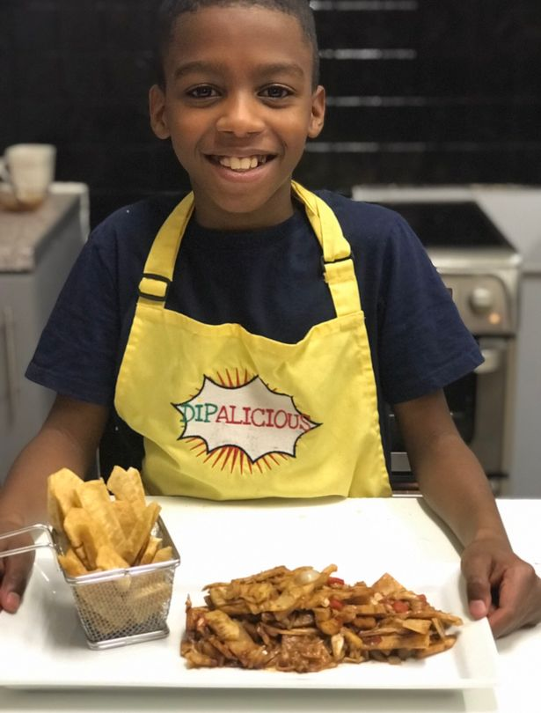
Black History Month – Influential Person of the Day
Omari McQueen
Omari McQueen has set up his own vegan restaurant in Croydon aged just 11.
Omari, who lives in Queens Road, Peckham, is the CEO of his own business Dipalicious, cooking up a range of amazing vegan dips and snacks, including his signature Jackfruit with Breadfruit and ‘Tortilla Madness’.

Slide 3
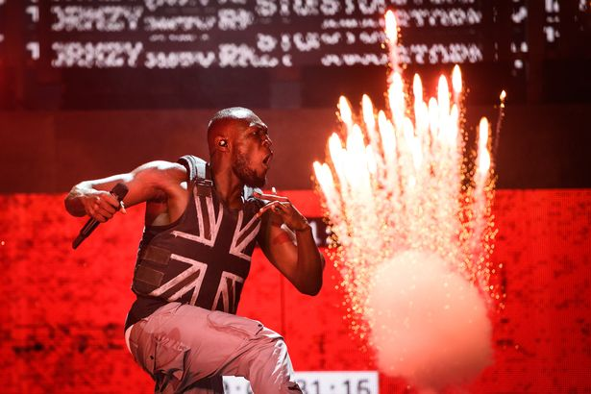
Black History Month – Influential Person of the Day
Stormzy
Stormzy performed in the headline slot on the Pyramid Stage on day three of Glastonbury Festival (Image: Getty)
Grime star Stormzy was raised by his mother in Thornton Heath and has gone on to do amazing things.
He made history this year at Glastonbury as the first solo black artist to headline the main stage.
Stormzy set up a scholarship to find Cambridge University places for black students last year.

Slide 4
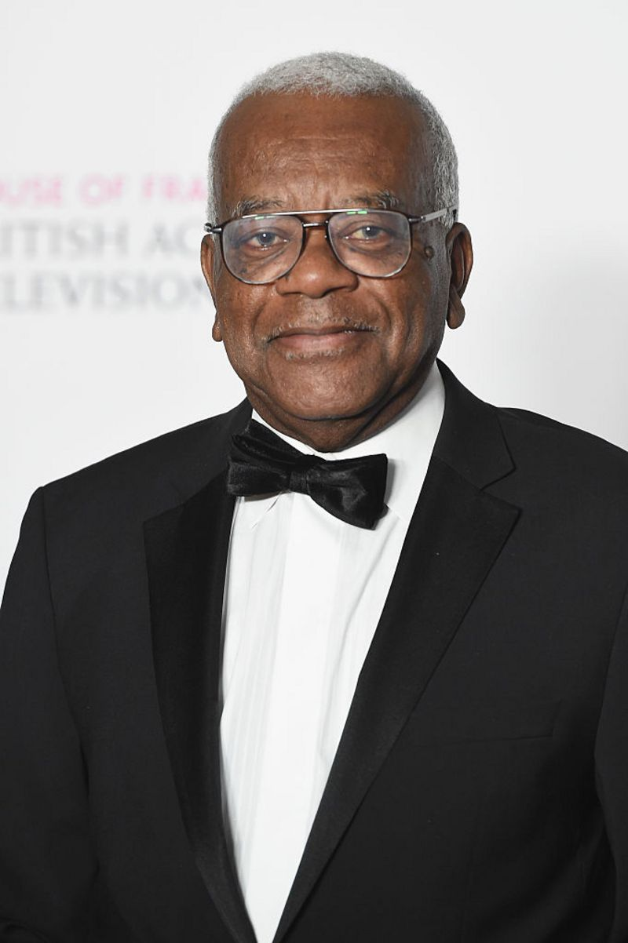
Black History Month – Influential Person of the Day
Sir Trevor MacDonald (1939-today)
You may have seen his face on the television before, as Sir Trevor MacDonald is one the most well-known presenters on TV in Britain.
He was born in Trinidad where he worked in the media, but came over to Britain in the late 1960s to work for the BBC in London.
He later moved to a different organisation called ITN and went on to become one of the most successful journalists in the country.
In 1999, he received a knighthood from the Queen for his work.

Slide 5
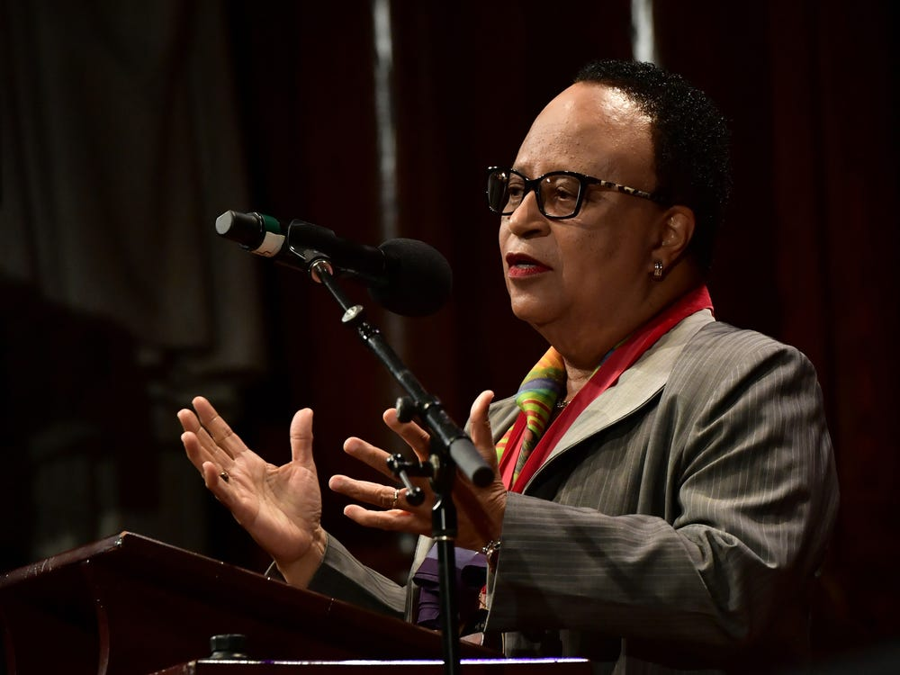
Black History Month – Influential Person of the Day
Dr. Shirley Jackson is the first black woman to lead a top-ranked research university.
A theoretical physicist, Jackson was the first black woman to earn a Ph.D. from MIT and the second black woman to earn a doctorate in physics in US history. In 2015, President Barack Obama selected her to receive the National Medal of Science.
She's now president of Rensselaer Polytechnic Institute (RPI) — the first black woman to lead a top-ranked research university. Since her appointment in 1999, she has helped raise over $1 billion in donations for philanthropic causes.

Slide 6
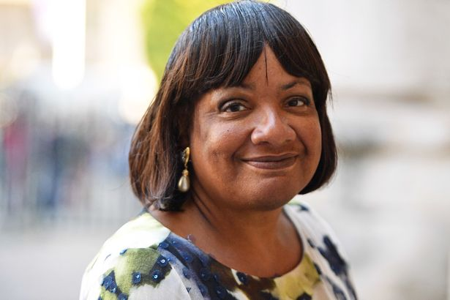
Black History Month – Influential Person of the Day
Dianne Abbot
Diane Abbott was the first ever black female MP and the country's longest serving black politician in the House of Commons.
She's been elected as Hackney North and Stoke Newington's MP since 1987 and has been known for sharing her views on human rights issue

Slide 7
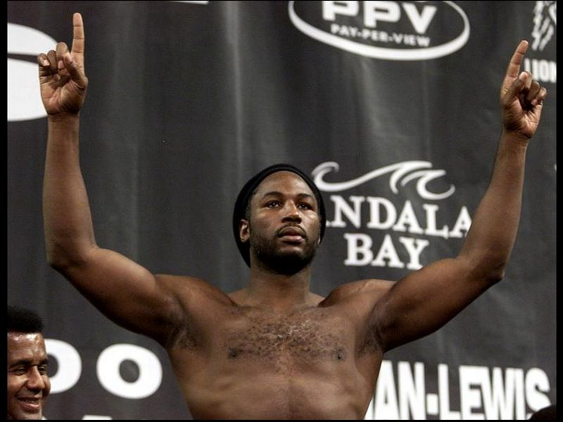
Black History Month – Influential Person of the Day
Lennox Lewis
"It's been great honour to be the standard bearer for boxing in the last decade. Let the new era begin."
Lennox Lewis, Boxer
In the world of sport, Lennox Lewis is one of the most successful British sportsmen of all time and his name is known all over the world.
He was a boxer who won 41 of his 44 professional fights, which is a pretty amazing record.
He announced his retirement from the sport in 2004, after his final fight on 21 June 2003 against the Ukrainian boxer Vitali Klitschko.

Slide 8
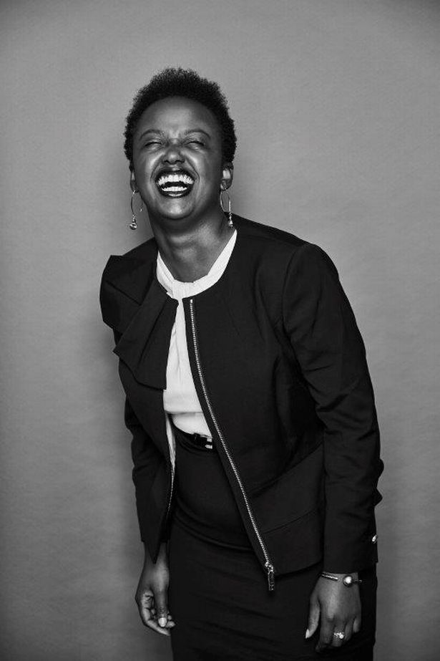
Black History Month – Influential Person of the Day
Natasha Shotunde
Natasha is fiercely passionate about social justice and raising awareness of imposter syndrome (Image: Natasha Shotunde)
Natasha Shotunde is a barrister specialising in family law and human rights, she comes from Tottenham.
She has done important work with people from low income families and on cases involving complex issues.

Slide 9
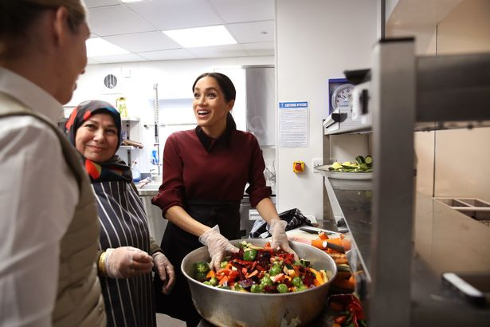
Black History Month – Influential Person of the Day
Meghan Markle
Meghan Markle, the Duchess of Sussex
Not only has she made history as the first black person to marry into the British royal family, she has also done incredible things with charities in London, like her work on the Grenfell cookbook, the National Theatre and Smart Works.

Slide 10
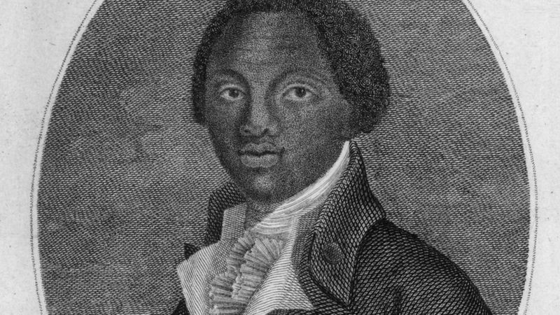
Black History Month – Influential Person of the Day
Olaudah Equiano
Olaudah Equiano's book about slavery is one of the earliest accounts about what it was like to be a slave - and it is one of the best-selling books about it.
Equiano was a slave himself, but he managed to buy his freedom and moved to London.
There, he became involved in the movement to abolish slavery.
In 1789, he published his autobiography called The Interesting Narrative of the Life of Olaudah Equiano or Gustavus Vassa, the African.
It made him a rich man and it became an extremely important piece of work for the people who were working hard to get rid of slavery.
Ira Aldridge (1807-1867)

Slide 11
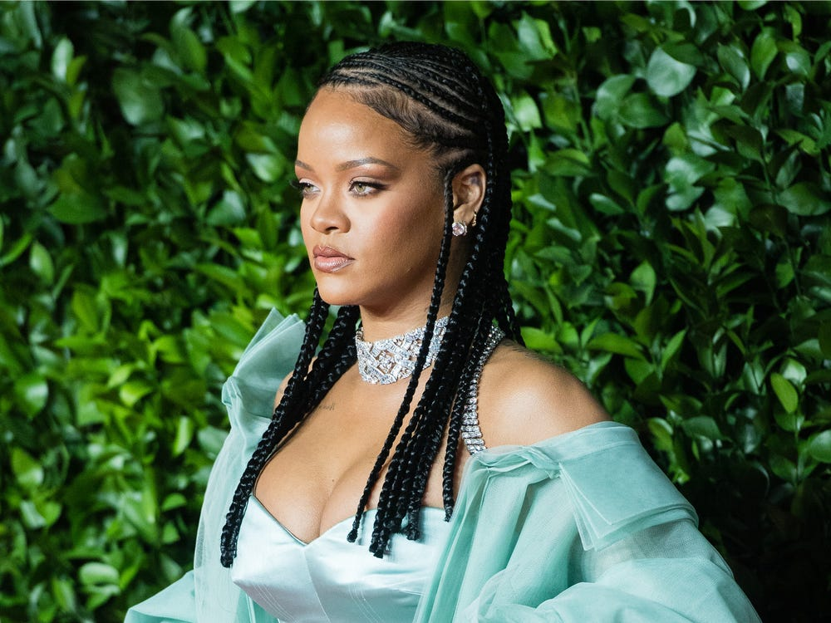
Black History Month – Influential Person of the Day
Rhianna
Not only a world famous talented musician, RiRi is a mogul. She has launched incredibly successful brands, Fenty Beauty and Savage X Fenty.

Slide 12
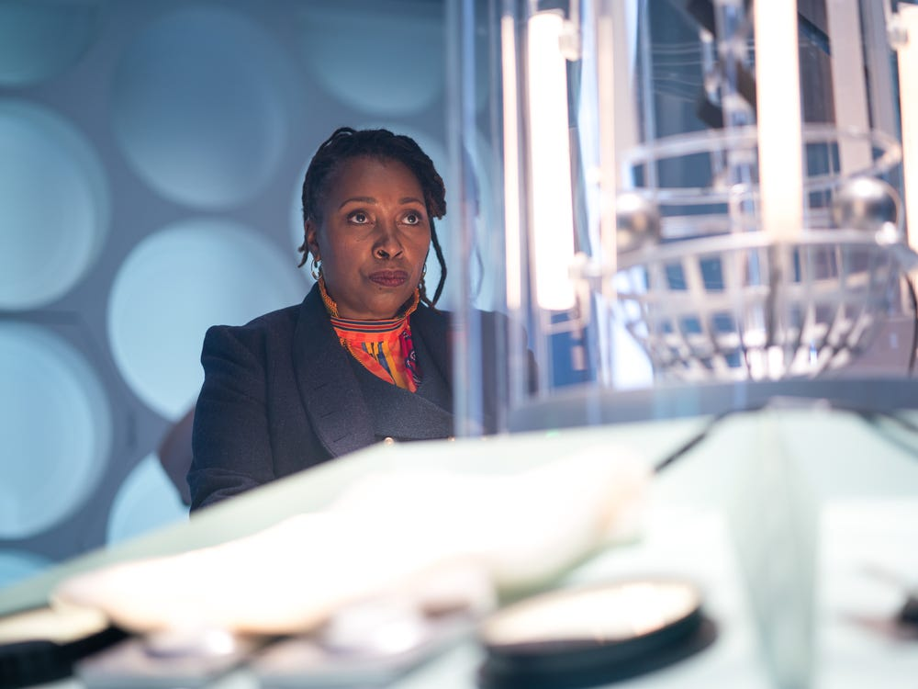
Black History Month – Influential Person of the Day
Jo Martin in the first black woman to play the Doctor in "Doctor Who" in the show's 57-year history
The British actress previously played Natalie Crouch on the BBC sitcom, "The Crouches," and played neurosurgeon Max McGerry on the BBC medical drama "Holby City."
This year, Martin makes history as the first black woman to play the Doctor in "Doctor Who." She shared the news in a Facebook post in January.
"This Sunday I am in Doctor Who, I have longed to be in this show. Watched it throughout my childhood wishing I was a dalek," she wrote

Slide 13
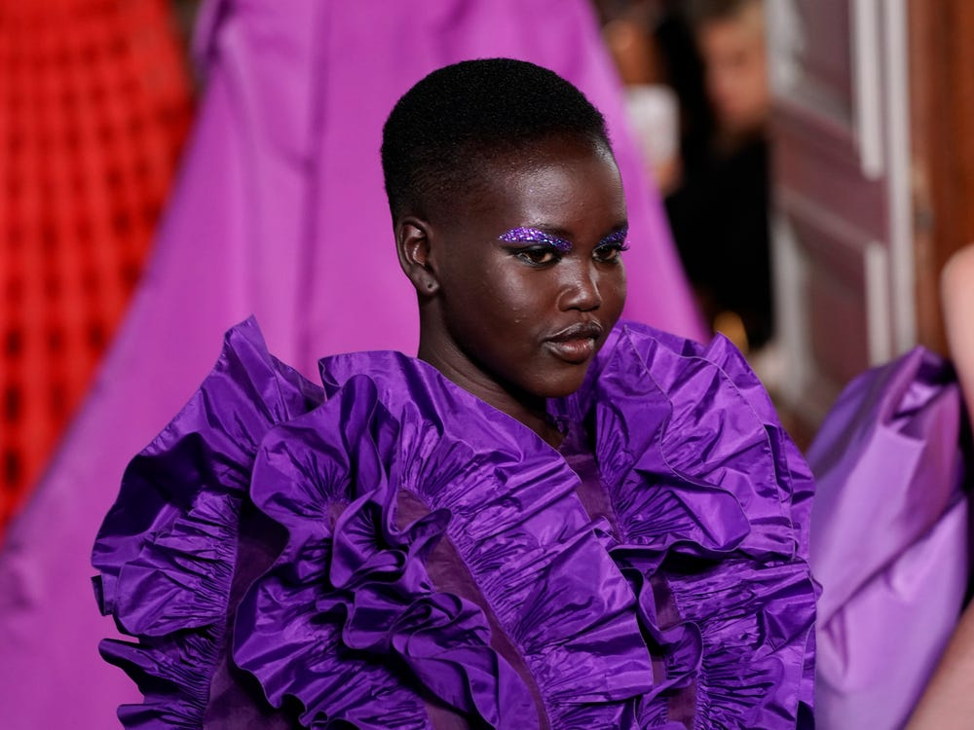
Black History Month – Influential Person of the Day
South Sudanese-Australian supermodel Adut Akech Bior is working with the UN to help refugees.
A former child refugee herself, 20-year-old Akech was recently featured on Time's 100 Next List (the only model this year). She made her international debut walking for Saint Laurent during Paris Fashion Week, and in 2019, she was named Model of the Year at the British Fashion Awards.
In a recent interview she spoke on what it means to be a refugee. "You don't wake up thinking, I'm going to be a refugee," she said. "The only difference between a refugee and someone who grew up in the Western world is that we were forced out of our own country, out of our homes, because of fear – not out of choice."

Slide 14
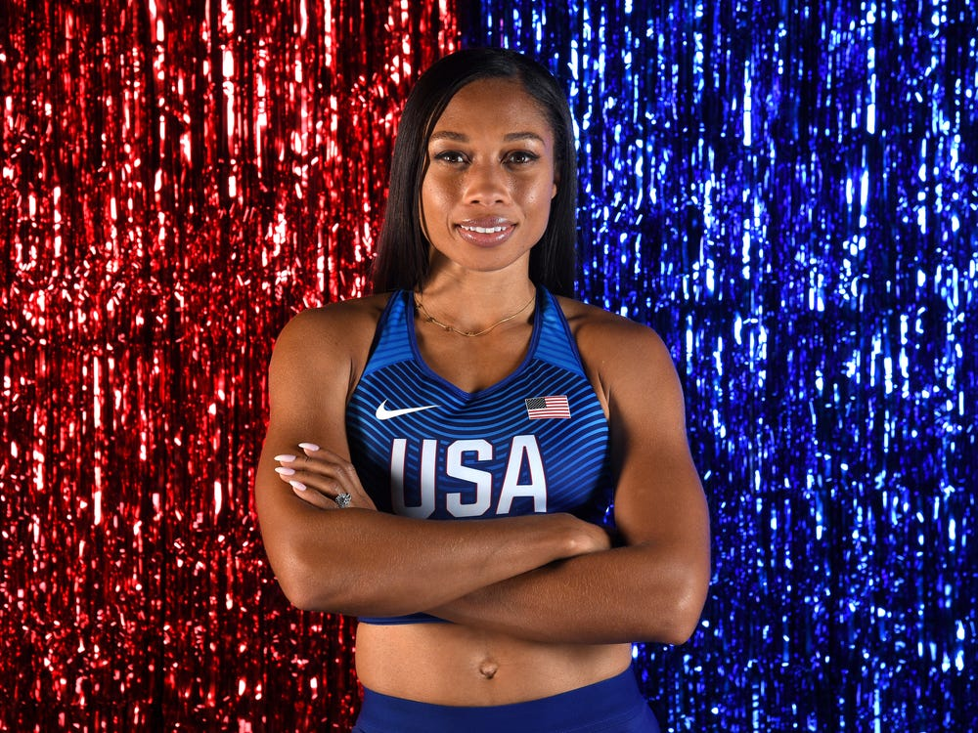
Black History Month – Influential Person of the Day
History's most decorated track and field Olympian, Allyson Felix, stands up for maternity protections.
Felix is one of the most decorated track and field athletes in history with nine Olympic medals — a record she shares with Jamaican sprinter Merlene Ottey. Six of Felix's Olympic medals are gold, the most of any female track and field star.
Even more incredibly, she won gold at the World Championships after becoming a mother in late 2018.,

Slide 15
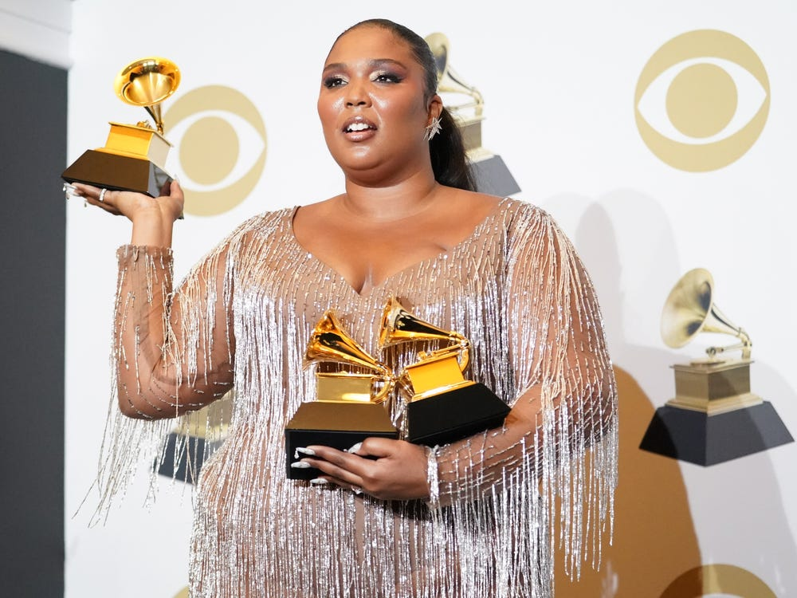
Black History Month – Influential Person of the Day
Lizzo was the most nominated artist at the 2020 Grammys.
Lizzo shot to fame in 2019 with the release of her third studio album, "Cuz I Love You." Her most played song was "Juice," but the success of the album popularized two of her previous singles, "Truth Hurts" and "Good as Hell," which were released in 2017 and 2016, respectively. In 2019, Time named the singer, dancer, and flutist Entertainer of the Year.
She was nominated for eight awards at the 62nd Annual Grammy Awards on January 2020 and won three.
Along with her work as a musician, Lizzo has been a champion for body positivity. After facing criticism for wearing a thong dress to a Lakers game, she took to Instagram to spread a message of acceptance: "Who I am, and the essence of me, and the things that I choose to do as a grown woman, can inspire you to do the same. They don't have to be like me – you need to be like you, and never ever let somebody stop you or shame you from being yourself."

Slide 16
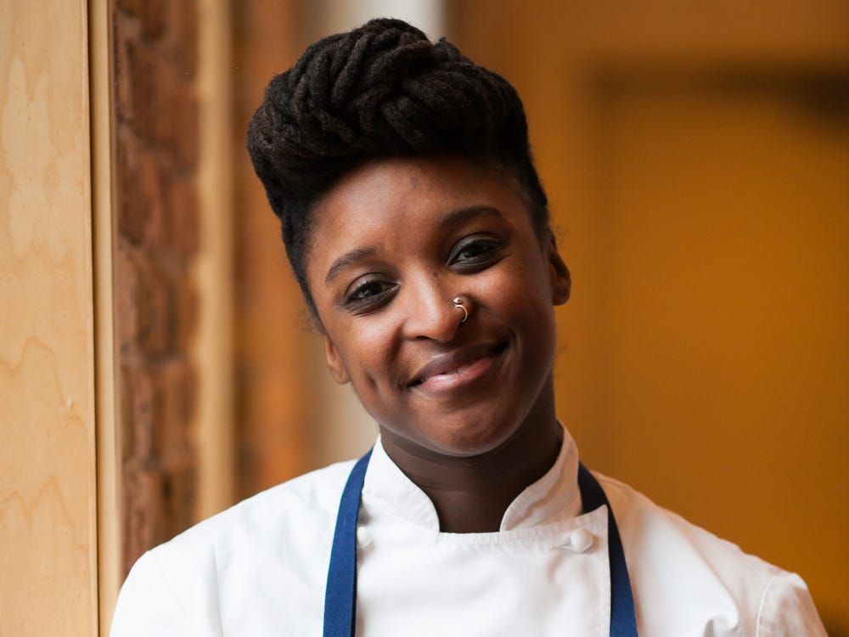
Black History Month – Influential Person of the Day
Chef Mariya Russell is the first black woman to earn a Michelin Star.
.
Russell is chef de cuisine at Kikkō, a Michelin-starred Japanese restaurant in Chicago. In September, she became the first black woman to be awarded a Michelin star in the Michelin Guide's 93-year history.
Originally from Springfield, Ohio, Russell became interested in food from a young age and began by cooking soul food and Midwestern staples, like mashed potatoes, fried chicken, and casseroles.
She later moved to Chicago to attend The Cooking and Hospitality Institute of Chicago. She and her husband went on to work together, eventually both joining Kikkō.
She said, "Thinking about [being] the only Black woman doing this is really, still very much so, blowing my mind. Representation is really important in all kinds of things, but in an industry like this, I think it's really cool."

Slide 17
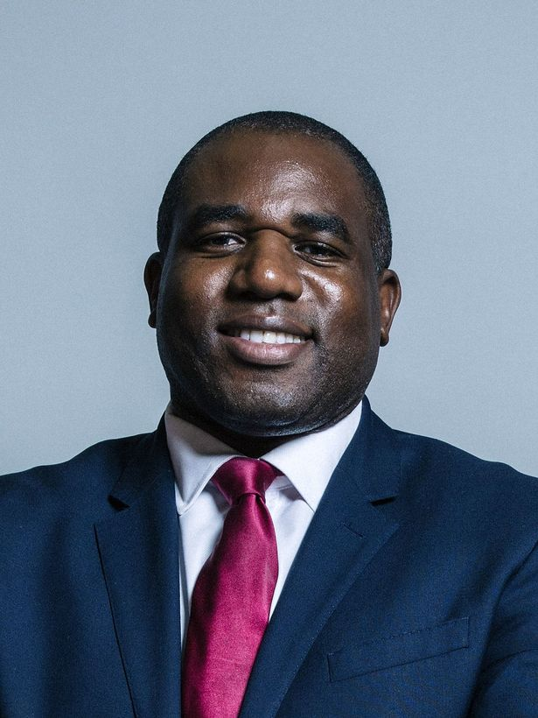
Black History Month – Influential Person of the Day
David Lammy
David Lammy has been the MP for Tottenham since 2000.
A Labour politician, he regularly speaks out about equality, human rights, crime and other issues affecting Londoners.

Slide 18
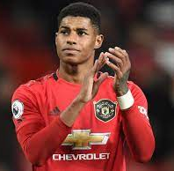
Black History Month – Influential Person of the Day
Marcus Rashford MBE (born 31 October 1997)
He plays for Manchester United and England.
With United, Rashford has won the FA Cup, EFL Cup, FA Community Shield and UEFA Europa League. Rashford scored on his England debut in May 2016, becoming the youngest English player to score in his first senior international match.
He is a campaigner against racism, homelessness and child hunger in the United Kingdom. Rashford has been praised for using his platform to be a political activist and philanthropist to drive societal change. He campaigned for Free Schools Meals to continue throughout the lockdown which provided vital food to millions of families.

